Slide 1
Network Discovery and User Preferences for Network Selection in 3G-WLAN Interworking Environment
Vishal Gupta
Under the supervision of Dr. Mukesh Kumar Rohil
Department of Computer Science and Information Systems
Birla Institute of Technology and Science, Pilani
E Mail: vishalgupta@pilani.bits-pilani.ac.in

Slide 2
Agenda:
Overall Problem
Related Work
Proposal Idea
4. Intermediate Results
5. Future Plans
6. Open Problems

Slide 3
Overall Problem in domain of “Vertical Handover in 3G-WLAN Interworking Environment”
Three Phases in downward Vertical Handover
Decision Algorithm/Model based on decision parameters
Network discovery
Handover Decision
Handover Execution
To discover a network, Mobile Terminal activates its 802.11 interface, and
receives service advertisements from Access Points in the vicinity.
Transfer the routing task to the new selected network for the proper forwarding of packets.
Decide whether to change the access network or not. If yes, to which 802.11 network.
Requires
Most of the Decision Models proposed in the Literature requires
Information (or values of decision parameters) about the Network to be delivered to Mobile Terminal
User Preferences for Network Parameters
HOW?
First Problem of my PhD
HOW?
Second Related Problem of my PhD

Slide 4
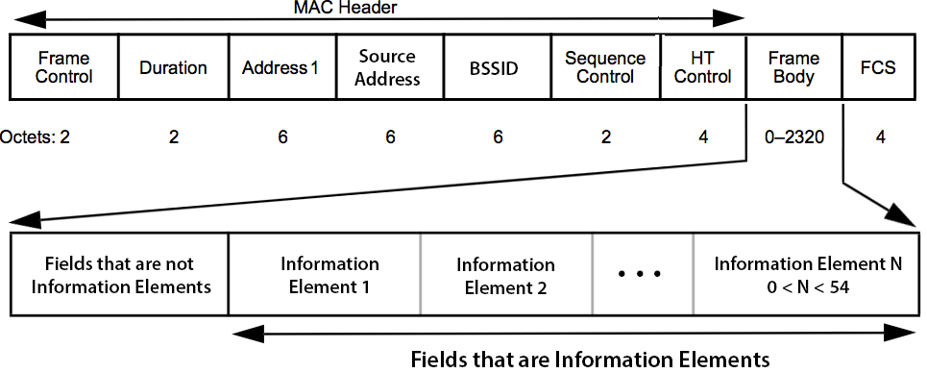
Related Work
In IEEE 802.11 network, Access Point (AP) periodically advertises the network by broadcasting the beacon frame which mainly contains the network information.
To facilitate the communication between any two 802.11 compatible devices, the syntax, semantics and arrangement of this information in the beacon is standardized by 802.11 standard.
Most of the decision models proposed in the literature require additional information, which is not the part of standard beacon frame.
For additional bits, R. Chandra et al [1] propose to use
6 Octets of BSSID Field
32 Octets of SSID field
255 Octets of Vendor Specific Information Element
Fig 1: 802.11 Beacon frame Format

Slide 5
Proposal Idea
Problem Statement 1: Without disturbing the arrangement of information as per IEEE 802.11 standard, how the additional information be stuffed in the beacon frame. The scope is not just limited to 3G-WLAN interworking environment (where additional information is very less), rather using the concept of fragmentation how the beacon frame can be used to carry general large advertisements.
Problem Statement 2: On what “parameters” and using which decision making “technique” the User Preferences should be captured and implemented. It is critical because changing the access network without considering the preferences of the user would mean "hacking" the private space of the subscriber.
Sub Problem of Problem Statement 2:
We Propose to use Analytic Hierarchy Process (AHP) as a “technique” to capture user preferences.
AHP is a popular MCDM technique. But in spite of its popularity it is often criticized in the literature for: (a) Principal Eigen Vector (b) Rank Reversals, and (c) Consistency Index.
So a related sub problem of problem statement-2 is to measure the intensity of the criticisms in AHP. In general this helps in suggesting the cases in which AHP should be avoided.

Slide 6
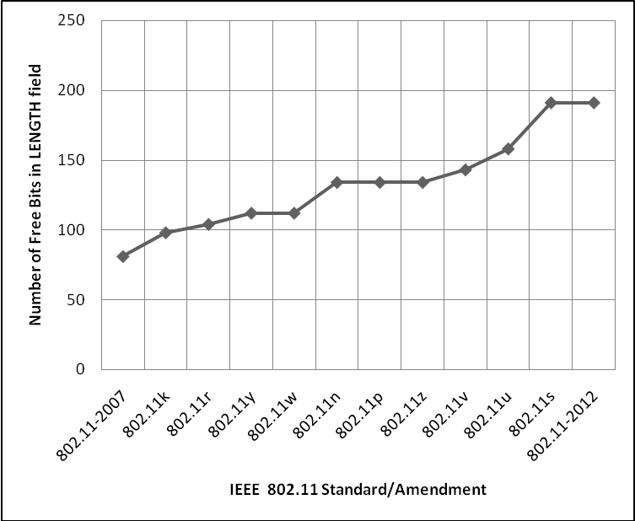
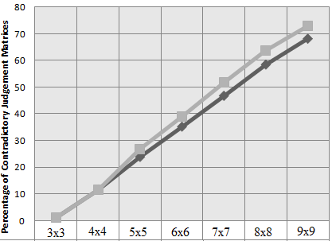
Intermediate Results
Other than BSSID and Vendor Specific fields, we propose to use LENGTH field to stuff additional bits. Considering 802.11-2012 standard, there can be a maximum of 18 octets on information which can be embedded.
With respect to Problem Statement 1, i.e. Beacon stuffing:
Fig 2: General format of Information Element present as frame body in 802.11 beacon
Fig 3:
With respect to Problem Statement 2, i.e. Measuring Criticisms in AHP
For contradictory matrices there exists no ranking of decision elements which satisfies all the judgements [3].
Shows that as the order of judgement matrix increases, its probability of being Contradictory also increases sharply [5].
Fig 4: Percentage of Contradictory Matrices for order 3x3 to 9x9

Slide 7
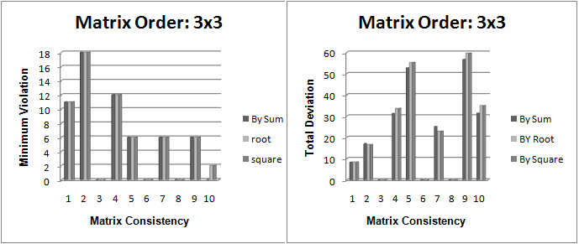
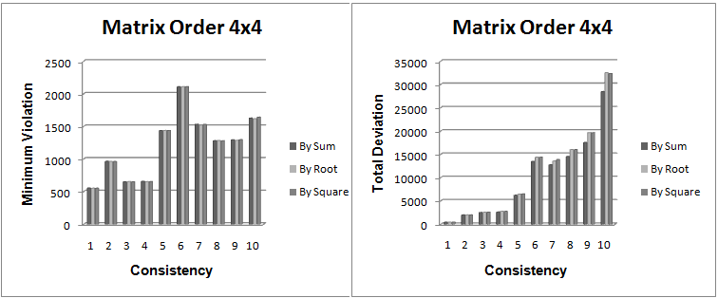
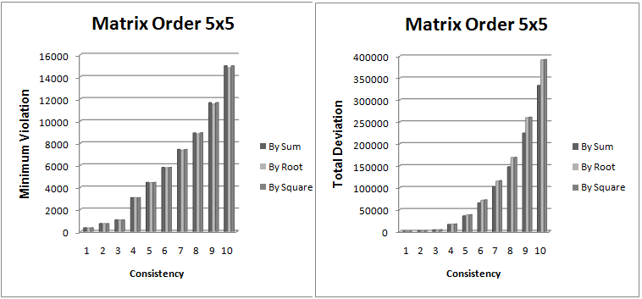
Intermediate Results while measuring the criticisms in AHP
There are three methods, reported in the literature, for generating the priority vector from the judgement matrix: By sum, By root, and By square.
Here we measured the efficiency of these methods on all possible judgement matrices of order 3x3 to 5x5 w.r.t. two metrics: Minimum Violation and Total Deviation.
Since checking all the higher order matrices is an exponential problem, we are still working on the design of approximation algorithm to generate them.
For 3x3 judgement matrix, all three methods gives the same results [6].
For 4x4 matrices, priority vector generated "by root" and "by square" are approximately the same [6].
For 5x5, priority vectors generated "by root" have least Minimum Violations, suggesting that it is the better method of generating the priority vector [6].
Fig 5: Validity of Principal Eigen Vector generation methods w.r.t. Minimum Violation and Total Deviation metrics.

Slide 8
“Future Plans” and “Open Problems”
Future Plans:
Identifying various parameters to capture User Preferences for network selection in 3G-WLAN interworking environment.
Designing a tool to facilitate capturing user preferences which gives instantaneous feedback of criticism measured to end user. In fact, this tool can be used at any place where AHP is used as a decision making MCDM technique.
Open Problem:
Embedding information in Length field of Information Elements of the Beacon frame requires the modification in device driver, both at Access Point and Mobile Station. How this can be achieved to make this idea a practically useful one.

Slide 9
Key References/Publications
[1] R. Chandra, J. Padhye, L. Ravindranath, A. Wolman, “Beacon-Stuffing: Wi-Fi without Associations”. In Proceedings of the Eighth IEEE workshop Mobile Computing Systems and Applications (Tucson, Arizona, February 26-27, 2007).
[2] Satty TL, "Fundamentals of Decision making with Priority Theory and Analytic Hierarchy process", RWS publications, Pittsburg, PA, 1994.
[3] M. Kwiesielewicz, E. v. Uden, "Inconsistent and contradictory judgements in pairwise comparison method in the AHP", Computers & Operations Research, Volume 31, Issue 5, April 2004, pp 713–719.
*[4] Vishal Gupta, M K Rohil. “IEEE 802.11-2012 Beacon Overloading with Additional Non-Standard Information”, COMSNET 2013 <Submitted>.
*[5] Vishal Gupta, M K Rohil, “An Experimental Measurement of Contradictory Judgement Matrices in AHP”, PDGC 2012 <Accepted>.
*[6] Vishal Gupta, M K Rohil, “Comparison of Methods for Deriving Priorities in Rank-Order Matrix of AHP”, International conference on data analysis and Learning Symbolic. <Accepted>
*[8] Vishal Gupta, Mukesh Kumar Rohil, "Interworking of 3G and 802.11 networks: Present and the Future ahead", International Journal of Mobile and adhoc network, vol 2 issue 1, Feb 2012.
*[9] Vishal Gupta, Mukesh Kumar Rohil, "ENHANCING WI-FI WITH IEEE 802.11U FOR MOBILE DATA OFFLOADING", International Journal of Mobile Network Communications and Telematics, .
*[10] Vishal Gupta, Mukesh Kumar Rohil, "Mobile data offloading: Benefits, Issues, and Technological Solutions", Advances in Computer Science, Engineering & Applications, pp 73-80, vol 167, Springer Berlin / Heidelberg.
* Papers till date as a result of my research work

Slide 10
Suggestions and Questions
Thank You

